Slide 1
Популярные библиотеки
Куликов Никита

Slide 2
Напоминание отметиться на портале

Slide 3
Утилитарные библиотеки
Картинки
DI
Тесты
Содержание занятия

Slide 4
Timber
Flipper
RxJava2Debug
Утилитарные библиотеки

Slide 5
Timber | Gradle
implementation 'com.jakewharton.timber:timber:4.7.1'

Slide 6
Timber | Как использовать
if (BuildConfig.DEBUG) { Timber.plant(new Timber.DebugTree()); }
Timber.i(“Test”)

Slide 7
Timber | Что внутри?
StackTraceElement[] stackTrace = new Throwable().getStackTrace(); if (stackTrace.length <= CALL_STACK_INDEX) { throw new IllegalStateException( "Synthetic stacktrace didn't have enough elements: are you using proguard?"); } return createStackElementTag(stackTrace[CALL_STACK_INDEX]);
https://github.com/JakeWharton/timber/blob/master/timber/src/main/java/timber/log/Timber.kt#L204

Slide 8
RxJava2Debug | Gradle
implementation 'com.akaita.java:rxjava2-debug:1.4.0'

Slide 9
RxJava2Debug | Как использовать
public class MyApplication extends Application { @Override public void onCreate() { super.onCreate(); // Enable RxJava assembly stack collection, to make RxJava crash reports clear and unique // Make sure this is called AFTER setting up any Crash reporting mechanism as Crashlytics RxJava2Debug
.enableRxJava2AssemblyTracking(new String[]{"com.example.myapp"}); } }

Slide 10
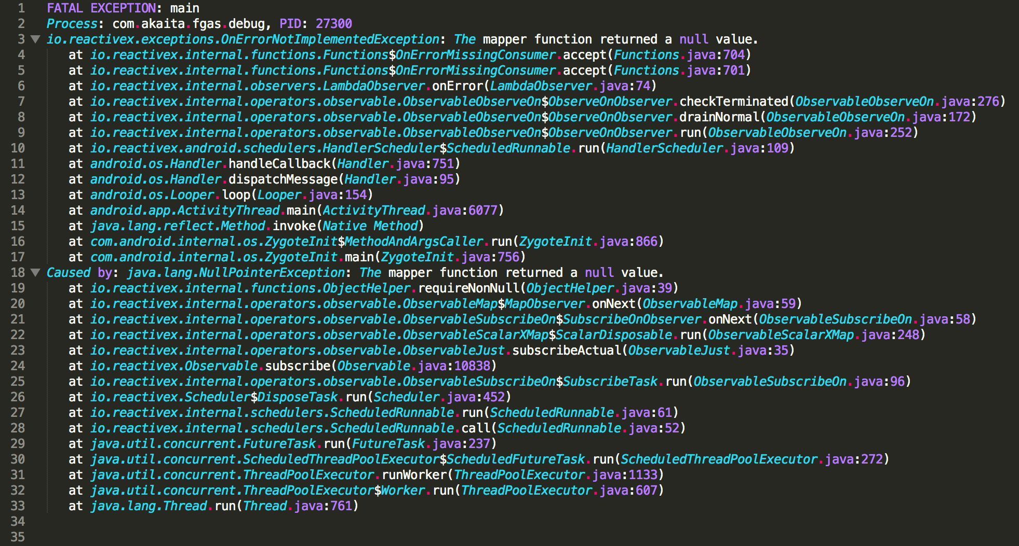
RxJava2Debug | Как использовать

Slide 11
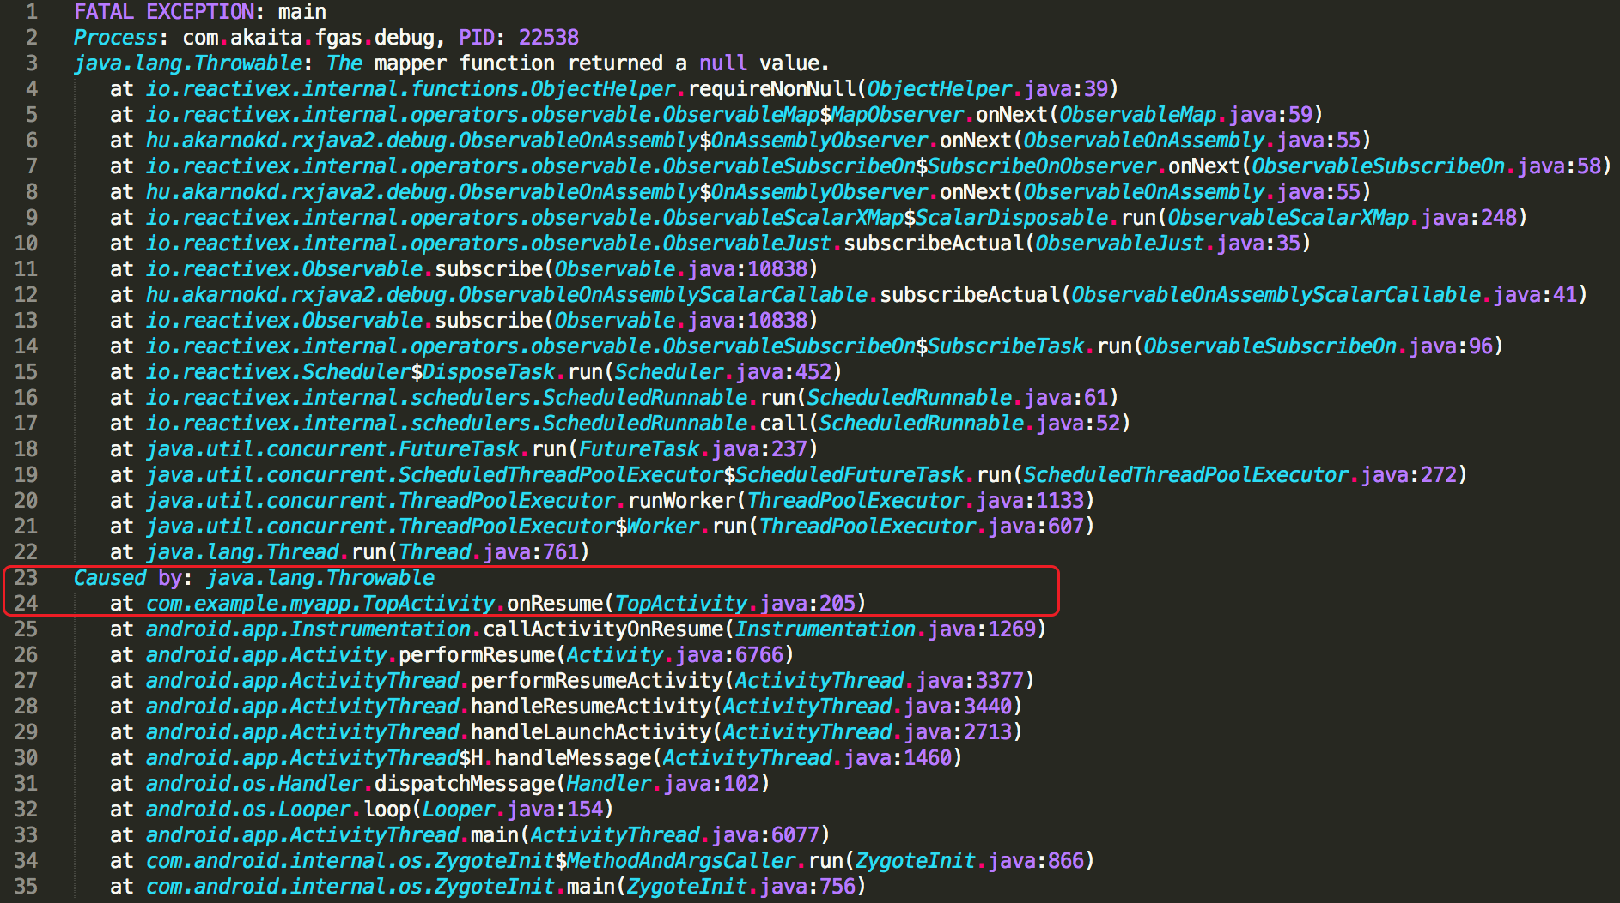

Slide 12
Flipper | Gradle
repositories { jcenter() } dependencies { debugImplementation 'com.facebook.flipper:flipper:0.66.0' debugImplementation 'com.facebook.soloader:soloader:0.9.0' releaseImplementation 'com.facebook.flipper:flipper-noop:0.66.0' }

Slide 13
Flipper | Manifest
<activity android:name="com.facebook.flipper.android.diagnostics.FlipperDiagnosticActivity" android:exported="true"/>

Slide 14
Flipper | Как использовать
import com.facebook.flipper.android.AndroidFlipperClient; import com.facebook.flipper.android.utils.FlipperUtils; import com.facebook.flipper.core.FlipperClient; import com.facebook.flipper.plugins.inspector.DescriptorMapping; import com.facebook.flipper.plugins.inspector.InspectorFlipperPlugin; public class MyApplication extends Application { @Override public void onCreate() { super.onCreate(); SoLoader.init(this, false); if (BuildConfig.DEBUG && FlipperUtils.shouldEnableFlipper(this)) { final FlipperClient client = AndroidFlipperClient.getInstance(this); client.addPlugin(new InspectorFlipperPlugin(this, DescriptorMapping.withDefaults())); client.start(); } } }

Slide 15
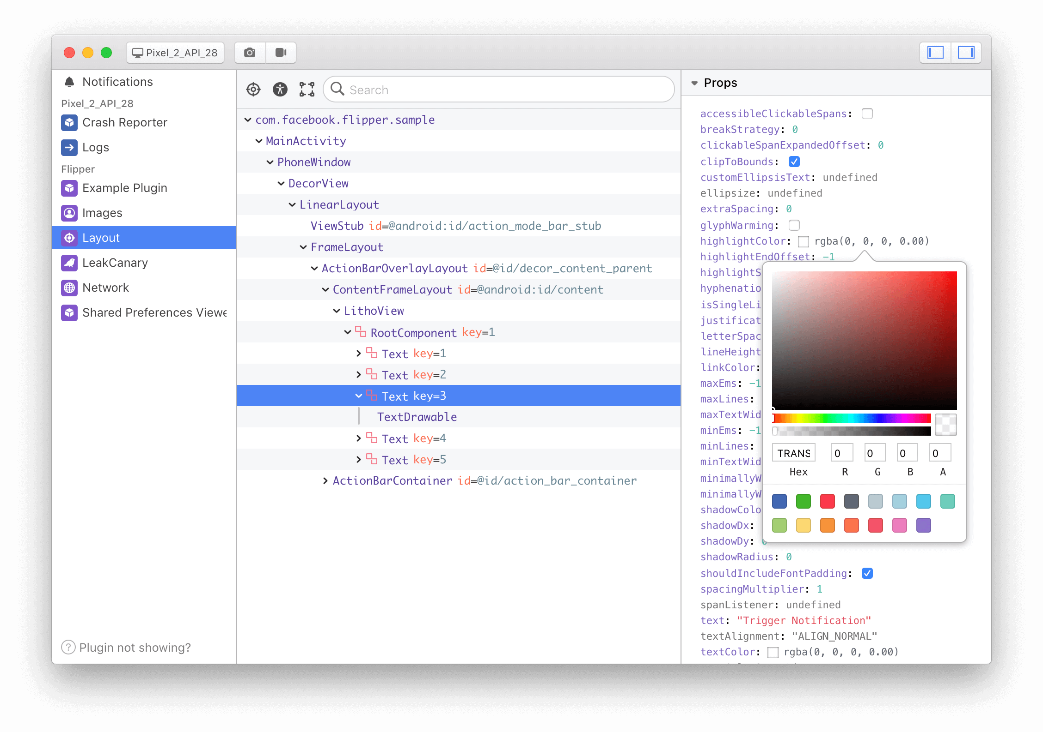

Slide 16
Flipper | Что внутри?
adb forward tcp:6100 tcp:7100

Slide 17
Glide
Картинки

Slide 18
Glide | Gradle
repositories { google() jcenter() } dependencies { implementation 'com.github.bumptech.glide:glide:4.11.0' annotationProcessor 'com.github.bumptech.glide:compiler:4.11.0' }

Slide 19
Glide | Proguard
-keep public class * implements com.bumptech.glide.module.GlideModule -keep class * extends com.bumptech.glide.module.AppGlideModule { <init>(...); } -keep public enum com.bumptech.glide.load.ImageHeaderParser$** { **[] $VALUES; public *; } -keep class com.bumptech.glide.load.data.ParcelFileDescriptorRewinder$InternalRewinder { *** rewind(); } # for DexGuard only -keepresourcexmlelements manifest/application/meta-data@value=GlideModule

Slide 20
Glide | Как использовать
ImageView imageView = (ImageView) findViewById(R.id.my_image_view); Glide.with(this).load("http://goo.gl/gEgYUd").into(imageView);

Slide 21
Glide | Что внутри
public class RequestManager implements ComponentCallbacks2, LifecycleListener

Slide 22
Dagger
koin
DI

Slide 23
Dagger | Gradle
// Add Dagger dependencies dependencies { api 'com.google.dagger:dagger:2.x' api 'com.google.dagger:dagger-android:2.x' api 'com.google.dagger:dagger-android-support:2.x' // if you use the support libraries annotationProcessor 'com.google.dagger:dagger-android-processor:2.x' annotationProcessor 'com.google.dagger:dagger-compiler:2.x' }

Slide 24
Dagger | Как использовать
@Component() public interface ApplicationComponent { }

Slide 25
Dagger | Как использовать
@Module public class ApplicationModule { private Context context; public ApplicationModule(Context context) { this.context = context; } @Provides @Singleton public Context provideEndpoint() { return context; } }

Slide 26
Dagger | Как использовать
@Component(modules = {
ApplicationModule.class
}) public interface ApplicationComponent { }

Slide 27
Dagger | Как использовать
DaggerApplicationComponent .applicationModule(ApplicationModule(this)) .create()

Slide 28
Dagger | Как использовать
@Component() public interface ApplicationComponent { void inject(MyClass myObject); }

Slide 29
Dagger | Как использовать
public class MyClass { @Inject public Context context; Application.getAppComponent().inject(this); }

Slide 30
Dagger | Как использовать
@Component() public interface ApplicationComponent { void plus(NetworkComponent cmpnt); }

Slide 31
Dagger | Что внутри

Slide 32
Koin | Gradle
buildscript { repositories { jcenter() } dependencies { classpath "org.koin:koin-gradle-plugin:$koin_version" } } apply plugin: 'koin'

Slide 33
Koin | Gradle
// Koin for Kotlin implementation "org.koin:koin-core:$koin_version" // Koin extended & experimental features implementation "org.koin:koin-core-ext:$koin_version" // Koin for Unit tests testImplementation "org.koin:koin-test:$koin_version" // Koin for Android implementation "org.koin:koin-android:$koin_version" // Koin Android Scope features implementation "org.koin:koin-android-scope:$koin_version" // Koin Android ViewModel features implementation "org.koin:koin-android-viewmodel:$koin_version" // Koin Android Experimental features implementation "org.koin:koin-android-ext:$koin_version"

Slide 34
Koin | Как использовать
// Given some classes class Controller(val service : BusinessService) class BusinessService() // just declare it val myModule = module { single { Controller(get()) } single { BusinessService() } }

Slide 35
Roboelectric
Mockk
Espresso
Тесты

Slide 36
Roboelectric | Gradle
testImplementation "org.robolectric:robolectric:4.4"

Slide 37
Roboelectric | Как пользоваться
@RunWith(AndroidJUnit4.class) public class MyActivityTest { @Test public void clickingButton_shouldChangeResultsViewText() throws Exception { Activity activity = Robolectric.setupActivity(MyActivity.class); Button button = (Button) activity.findViewById(R.id.press_me_button); TextView results = (TextView) activity.findViewById(R.id.results_text_view); button.performClick(); assertThat(results.getText().toString(), equalTo("Testing Android Rocks!")); } }

Slide 38
Mockk | Gradle
testImplementation "io.mockk:mockk:{version}"

Slide 39
Mockk | Как пользоваться
val car = mockk<Car>() every { car.door(DoorType.FRONT_LEFT).windowState() } returns WindowState.UP car.door(DoorType.FRONT_LEFT) // returns chained mock for Door car.door(DoorType.FRONT_LEFT).windowState() // returns WindowState.UP verify { car.door(DoorType.FRONT_LEFT).windowState() } confirmVerified(car)

Slide 40
Espresso | Как пользоваться
// Щелчок кнопки у первой активности public void onClick(View view) { EditText nameEditText = (EditText) findViewById(R.id.editTextName); Intent intent = new Intent(MainActivity.this, SecondActivity.class); intent.putExtra("name", nameEditText.getText().toString()); startActivity(intent); } // Запускается вторая активность @Override protected void onCreate(Bundle savedInstanceState) { super.onCreate(savedInstanceState); setContentView(R.layout.activity_second); String user = ""; user = getIntent().getExtras().getString("name"); TextView infoTextView = (TextView)findViewById(R.id.textViewInfo); infoTextView.setText("Hello " + user); }

Slide 41
Espresso | Как пользоваться
public class MainActivityTest { @Rule public ActivityTestRule<MainActivity> mActivityRule = new ActivityTestRule<>( MainActivity.class); @Before public void setUp() throws Exception { } @Test public void onClick() throws Exception { onView(withId(R.id.editTextName)).perform(typeText("Barsik")); onView(withId(R.id.button)).perform(click()); onView(withId(R.id.textViewInfo)).check(matches(withText("Hello Barsik"))); } }

Slide 42
Попробуем практику

